Slide 1





Tumor Segmentation in Medical Images:
Analysis of 3D Architecture Design Approaches
CS64201 Advance Artificial Intelligence
Professor: Arvind Bansal
Presented By: Anh Tuan Tran, Jared Young

Slide 2
Application Areas Studied
Nowadays, a huge number of patients around the world suffer from brain tumor cancer. Early detection and accurate segmentation of the tumor can greatly increase the survival rate and improve the quality of life for patients.
Developing fast and reliable automatic segmentation methods has become a critical research topic in medical imaging. In particular, deep learning models have proven to be the most effective approaches.
Brain Tumor Segmentation Approaches Studied:
Foundational Volumetric Segmentation
Hybrid Architecture
Strong 3D encoder-decoder segmentation models learn directly from full MRI volumes and establish baseline for volumetric tumor segmentation.
Volumetric segmentation models enhanced with Transformer, dynamic convolution, attention, or adversarial refinement to improve global reasoning and tumor boundary modeling.

Slide 3
Fundamentals of Deep Learning
Key Algorithms & Strategies
Calculations & Functions
V-NET
DSNET
TransBTS
nnU-Net
Architectural Elements
3D-CNN, 3D-Deconvolution, 3D-Max Pooling
Mechanism & Mapping
Softmax, Attention mechanism
Network Features
Skip connection

Slide 4
Issues and Parameters
Issues
Parameters
Tumors
Can appear anywhere
Irregular shapes and sizes
Unclear boundaries
Inconsistent intensity values
Dataset
Imbalance dataset
Kernel Selection
Choosing size of kernel is depended on user configuration
Pooling Logic
No reasoning provided for choosing max pooling instead of average pooling

Slide 5
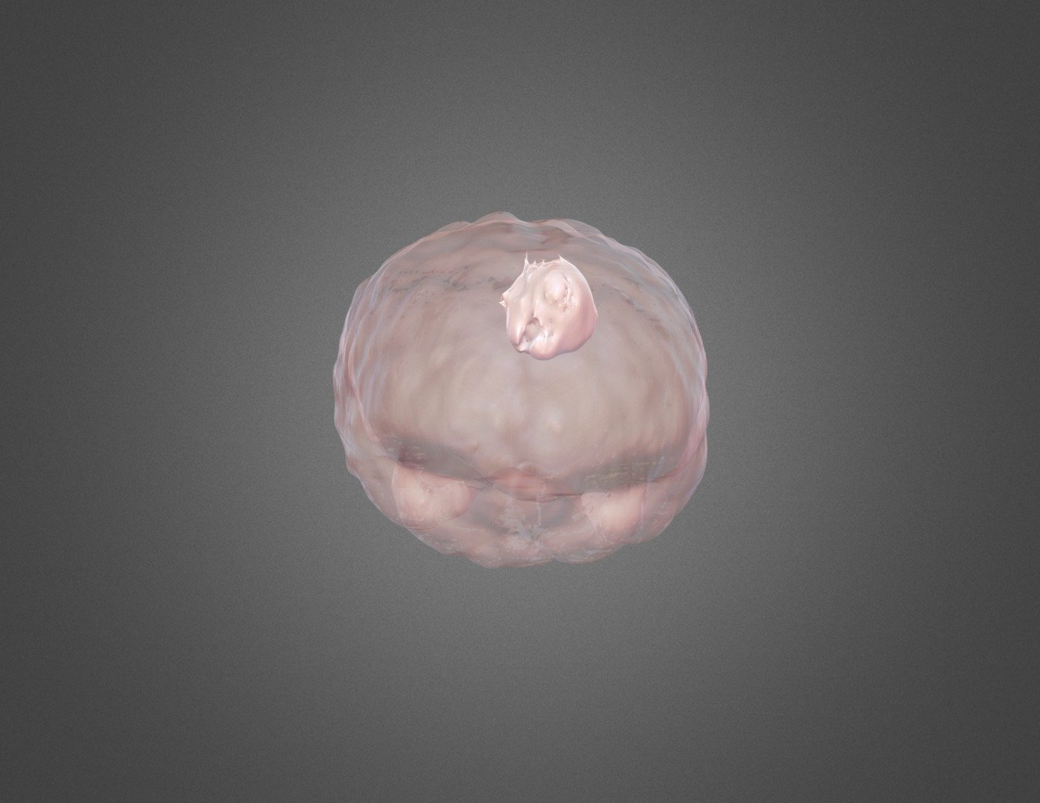
Brain Tumor Segmentation with DSNet Architecture
PAPER 1 | DSNet
Problem Definition
3D Structure: Direct segmentation without slicing into 2D images (T1, T1c, T2, FLAIR).
Voxel Focus: Transitioning from pixel-based to voxel-based analysis.
DL Approach: Inspired by proven 2D deep learning segmentation calculations.
Attention: Leveraging powerful Attention mechanisms for precision.

Slide 6
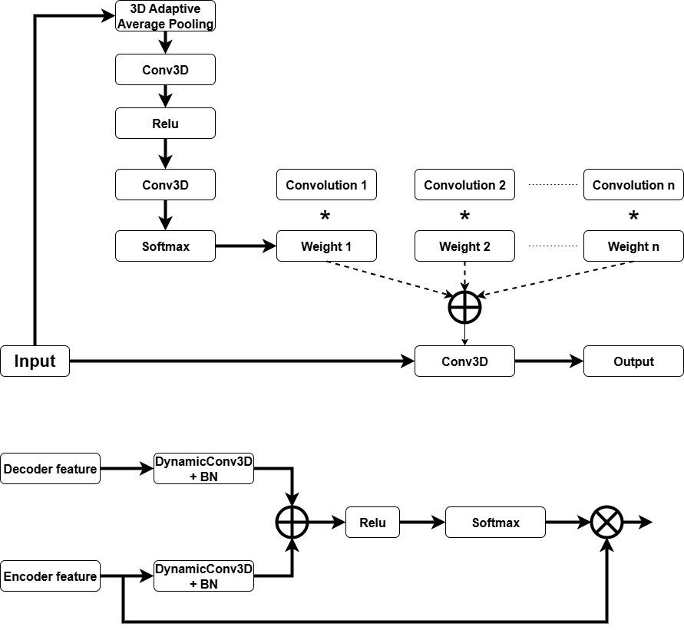
DSNet Model Proposal
PAPER 1 | DSNet
Figure 1: Dynamic Convolutional Neural Network Structure
Figure 2: Attention Mechanism in Skip Connections

Slide 7
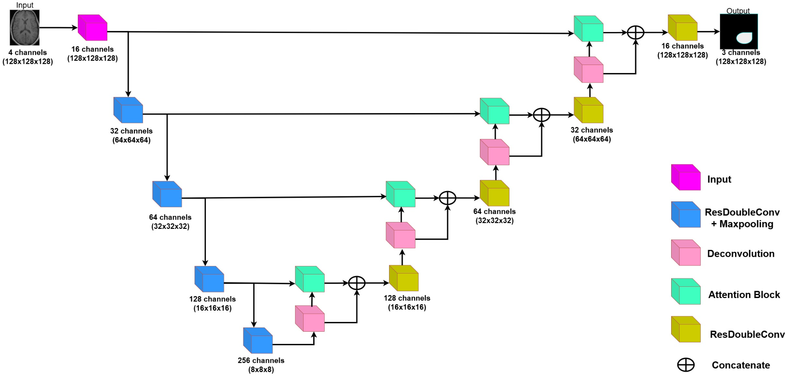
Their Proposed Model: DSNet Architecture
PAPER 1 | DSNet
Figure 3: DSNet segmentation model architecture.

Slide 8
Issues and Limitations in this Paper
PAPER 1 | DSNet
Albeit its effectiveness, there are many issues should be considered:
account_tree
memory
1. High Architectural Complexity
Combines dynamic convolution, attention mechanisms, and adversarial learning → difficult to design, implement, and interpret.
2. High Computational Cost
Generates adaptive filters for each input → increases runtime and GPU memory usage (Batch-size problem).
warning
psychology
3. Risk of Overfitting
Complex architecture with many parameters → requires large datasets to generalize well.
4. Difficult Optimization
Multiple components (dynamic layers + attention + GAN) interact → harder to train than standard CNNs.

Slide 9
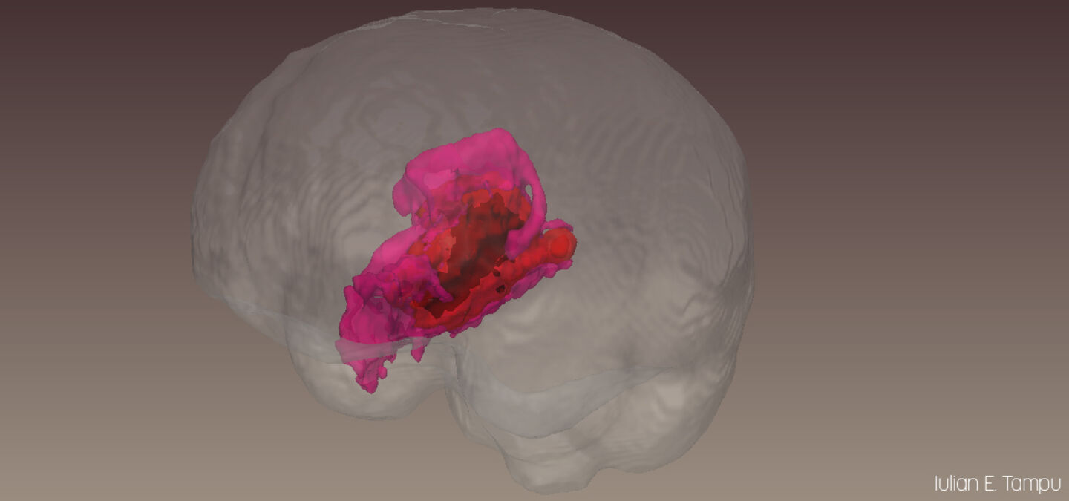
Brain Tumor Segmentation with V-NET Architecture
PAPER 2 | V-NET
Problem Definition
view_in_ar
psychology
Direct 3D Segmentation
Segmentation on 3D structures without sliding to many 2D images (T1, T1c, T2, FLAIR).
Inspired by 2D Deep Learning
Adapts calculation techniques from established 2D segmentation deep learning models.
grid_view
layers
Voxel-Based Approach
Processes volumetric data by considering voxels instead of standard pixels for higher precision.
Learnable Downsampling
Uses learnable convolution layers for downsampling instead of static max/avg pooling.

Slide 10
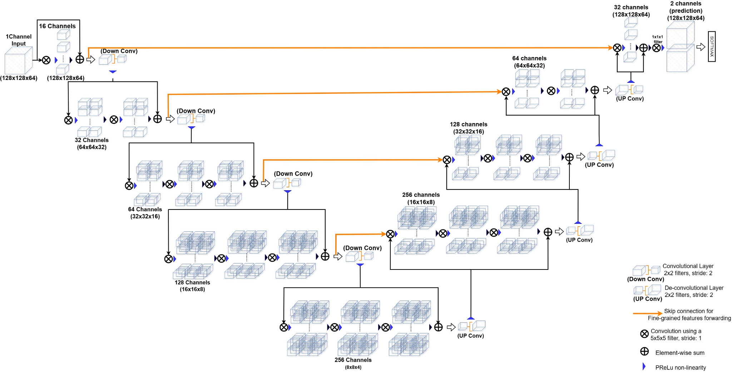
V-Net Model Architecture
PAPER 2 | V-NET
Figure 3: Detailed V-Net Architecture visualization

Slide 11
Issues and Limitations: V-Net
PAPER 2 | V-NET
Albeit its effectiveness, there are several key issues and constraints inherent to the architecture:
1. High Computational Cost
Uses full 3D convolutions (e.g., 5×5×5 kernels) which significantly increases computation compared to 2D models.
2. High Memory Consumption
Processes entire volumetric data simultaneously, requiring large GPU memory and often resulting in very small batch sizes.
3. Fixed Input Size Constraint
Requires a predefined volume size (e.g., 128×128×64), reducing operational flexibility for diverse datasets.
4. Loss of Fine Details
Downsampling in the encoder may discard crucial boundary information, affecting segmentation accuracy for small structures.

Slide 12
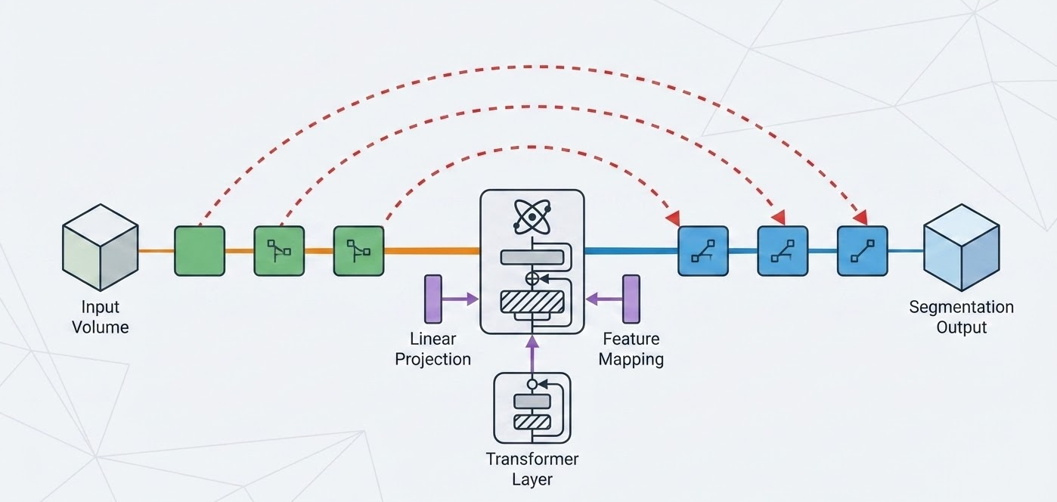
PAPER 3 | TRANSBTS
TransBTS | Problem Definition and Research Contribution
Problem & gap
Method
Workflow
Results & critique
Problem Definition
Multimodal 3D brain tumor segmentation on BraTS 2019 and 2020. Evaluated on Whole Tumor (WT), Tumor Core (TC), and Enhancing Tumor (ET).
Research Gap
Standard 3D CNNs excel at local structure but lack explicit long-range dependency modeling.
Contribution: TransBTS
Integrates a Transformer into a 3D encoder-decoder to jointly learn local and global context.
Main Lever: Global Context Modeling in 3D Pipeline
Why it matters
Improves tumor localization accuracy via deep learning.

Slide 13
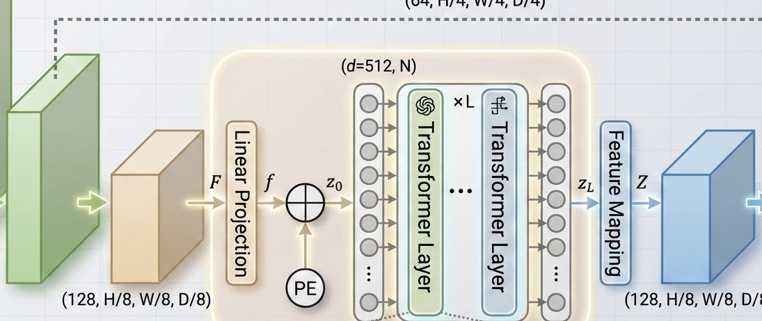
PAPER 3 | TRANSBTS
5
TransBTS | Deep Learning Method
Problem & gap
Method
Workflow
Results & critique
Technical Implementation
• Input: 4-channel MRI crop (T1, T1ce, T2, FLAIR)
• Encoder: 3D CNN downsamples to OS=8, K=128 channels
• Projection: 3x3x3 mapping (128 → 512), flattened to N tokens
• Bottleneck: Transformer layers model global interactions
• Decoder: 3D CNN upsamples to segmentation mask
• Design: Tokenizes CNN features to preserve local 3D structure
Tokenization Strategy
OS = 8, d = 512
Key Architectural Benefit
Retains local 3D structure
Hybrid Logic: CNN Locality + Transformer Global Reasoning

Slide 14
PAPER 3 | TRANSBTS
6
TransBTS | Workflow, Training, and Ablation Logic
Problem & gap
Method
Workflow
Results & critique
Pipeline & Training
Workflow: multimodal MRI → crop and augment → CNN encoder → Transformer bottleneck → CNN decoder → 4-class mask.
Uses softmax Dice loss, Adam, LR 0.0004 (poly decay), weight decay 1e-5, and TTA at inference.
Ablation sweet spot
L = 4, d = 512
Lightweight variant
15.14M params
Ablation Logic
Ablation 1: OS = 8 outperforms OS = 16. Suggests better token resolution helps global modeling.
Ablation 2: CNN skip connections outperform Transformer skips. Restores spatial detail better.
Efficiency Note: A lighter TransBTS cuts params/FLOPs substantially with minimal performance drop.
speed

Slide 15

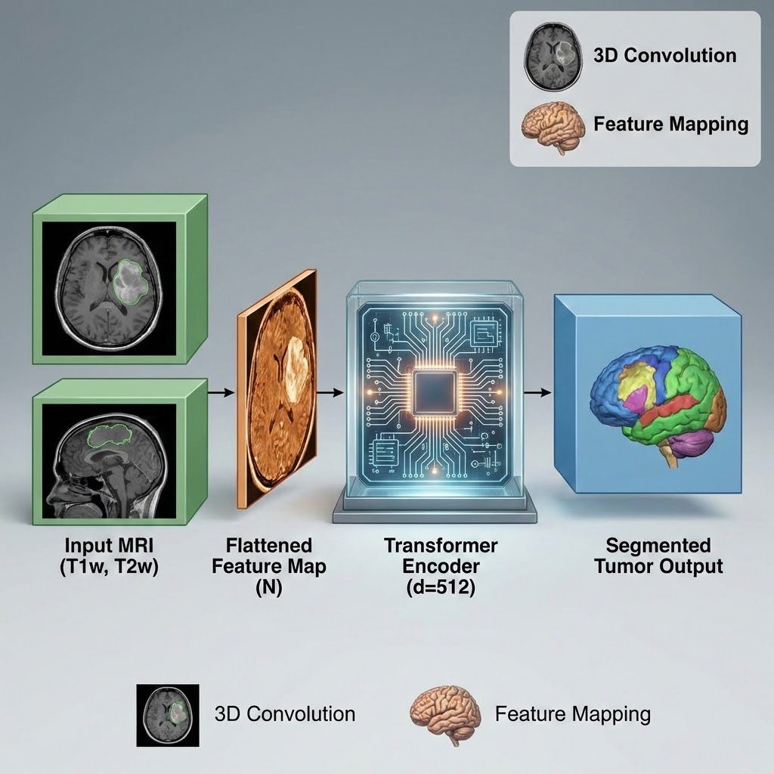
PAPER 3 | TRANSBTS
7
TransBTS | Results, Strengths, and Limits
Problem & gap
Method
Workflow
Results & critique
Performance Benchmarks (with TTA)
• BraTS 2019: Dice ET/WT/TC = 78.93 / 90.00 / 81.94
• BraTS 2020: Dice = 78.73 / 90.09 / 81.73; HD95 significantly better than 3D CNN baselines.
Strengths: Clear architecture hypothesis supported by extensive ablations and qualitative masks.
Limitations: High training cost; memory-constrained attention; lack of external generalization testing.
Discussion Value: Key paper for debating global context vs. computational complexity trade-offs.
Superior performance on all regions (ET/WT/TC) compared to baseline 3D CNNs
Key result
BraTS 2020 val
ET gain over 3D U-Net
+9.97 ET Dice points

Slide 16
PAPER 4 | NNU-NET
8
nnU-Net | Problem Definition and Research Contribution
Problem & gap
Method
Workflow
Results & critique
Problem & Research Question
Problem: BraTS 2020 brain tumor segmentation using the same WT / TC / ET evaluation regions.
Question: How strong can a plain 3D U-Net pipeline be without architectural novelty?
Main Improvement
Disciplined pipeline design and objective alignment
Research Contributions
Contribution 1: nnU-Net serves as a strong standardized baseline for the task.
Contribution 2: Adds BraTS-specific targets, augmentation, postprocessing, and model selection.
Contribution 3: Shows that evaluation design changes what the “best” model looks like.
architecture
The paper focuses on rigorous engineering and evaluation alignment rather than introducing complex new network architectures.

Slide 17
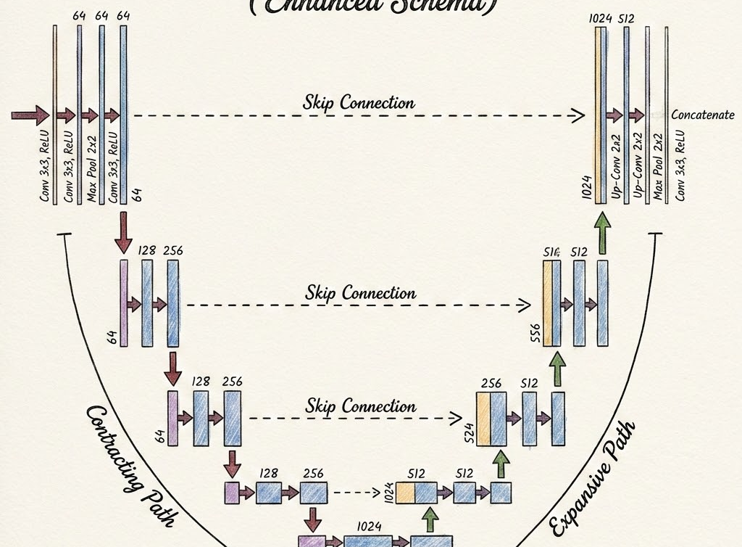
PAPER 4 | NNU-NET
9
nnU-Net | Baseline Deep Learning Method
Problem & gap
Method
Workflow
Results & critique
Architecture & Input
• Baseline: Plain 3D U-Net-like encoder-decoder with skip connections and deep supervision.
• Input: 128×128×128 patch size; five downsamplings to 4×4×4 bottleneck; channels 32 → 320.
• Preprocessing: Brain voxels normalized per image; non-brain voxels remain zero.
Loss & Optimization
• Loss: Dice + cross-entropy on edema, necrosis / non-enhancing tumor, and enhancing tumor.
• Training: SGD with Nesterov momentum (0.99), poly learning-rate decay, 1000 epochs.
This paper wins without a novel backbone: the baseline architecture stays intentionally plain
Patch size
Backbone choice
128 × 128 × 128
Plain U-Net-like

Slide 18
PAPER 4 | NNU-NET
10
nnU-Net | BraTS-Specific Workflow and Optimizations
Problem & gap
Method
Workflow
Results & critique
Workflow Optimizations
• Region-based training: predicts WT, TC, and ET directly using sigmoid outputs and binary cross-entropy.
• Data & Training: stronger augmentation, batch Dice, BN experiments, and larger-batch variants.
• Postprocessing: removes tiny ET regions below learned threshold; relabels as necrosis to preserve TC.
• Model Selection: ranking-aware logic (reimplementing BraTS rank-then-aggregate) vs mean metrics.
• Final Workflow: plain backbone + task-aligned targets + evaluation-aware selection + ensemble.
Baseline
Region targets
Ranking-aware
selection
Ensemble
Novelty is in matching training and selection to BraTS evaluation, not the network architecture itself.
settings
Pipeline Design
straighten
Task Alignment
assessment
Eval-Aware

Slide 19
PAPER 4 | NNU-NET
11
nnU-Net | Results, Strengths, Limits, and Discussion Value
Problem & gap
Method
Workflow
Results & critique
Quantitative Results
Validation: Dice rises from 84.18 (baseline) to 85.58 (best); mean HD95 drops from 15.30 to 11.93.
Final Test (BraTS 2020): WT / TC / ET = 88.95 / 85.06 / 82.03. Won the competition.
Competition Winning Score (Dice)
88.95 / 85.06 / 82.03
insights
Discussion Value
Evaluation & Critique
Strength: Disciplined pipeline design outperforms more exotic backbones.
Limitation: Relies on 25-model ensemble; postprocessing may delete true small lesions.
Discussion: Questioning leaderboard optimization vs. meaningful tumor detection.
nnU-Net proves that rigorous engineering and evaluation alignment are more critical for success than architectural novelty.

Slide 20
Comparative Discussion
The report groups the four papers into two architecture themes: foundational volumetric systems and hybrid refinements built on those 3D backbones.
Foundational Volumetric Segmentation
V-Net, nnU-Net
Hybrid Architectures
TransBTS, DSNet
Architectural focus: stable 3D encoder--decoder baselines with strong volumetric continuity.
Strengths:
clear reconstruction logic, strong 3D context, task-aligned optimization.
Limitations:
may leave global/adaptive modeling capacity on the table; some gains rely on heavy pipeline engineering.
Architectural focus: strengthen 3D segmentation with Transformer, dynamic convolution, attention, and adversarial refinement.
Strengths:
richer global reasoning, adaptive feature selection, stronger tumor boundary modeling.
Limitations:
higher memory cost, greater architectural complexity, and harder optimization/deployment.
Trade-off: stability, interpretability, and simpler optimization.
Trade-off: stronger representation at higher computational and engineering cost.
Best fit depends on the bottleneck: stronger 3D foundations vs. stronger global/adaptive modeling.
Notes:
[Sources]
- Content synthesized from the user-provided report draft discussing V-Net, nnU-Net, TransBTS, and DSNet.
- Kent State logos cropped from the user-provided presentation PDF.
[/Sources]

Slide 21
Key Takeaways
Main Conclusion: Strong brain tumor segmentation stems from refining robust 3D volumetric foundations.
view_in_ar
01. Why 3D Matters
architecture
02. Volumetric Baselines
Full MRI volumes preserve cross-slice continuity and spatial context that 2D slice-wise approaches can lose.
V-Net and nnU-Net demonstrate that robust 3D encoder-decoder designs provide competitive results.
hub
03. Hybrid Refinements
psychology
04. The Performance Balance
TransBTS and DSNet add global reasoning via Transformers and dynamic convolution for boundary modeling.
Success comes from balancing context, feature reuse, global reasoning, and computational practicality.
Future: Combining strong 3D backbones with selective hybrid enhancements.
Notes:
[Sources]
- Content synthesized from the user-provided report draft and current presentation theme.
- Kent State logos cropped from the user-provided presentation PDF.
[/Sources]

Slide 22
References
[1] A. Yeafi, M. Islam, and M. S. U. Yusuf, “A deep learning framework for 3D brain tumor segmentation and survival prediction,” Healthcare Analytics, vol. 8, p. 100418, 2025, doi: 10.1016/j.health.2025.100418.
[2] F. Milletari, N. Navab, and S.-A. Ahmadi, “V-Net: Fully convolutional neural networks for volumetric medical image segmentation,” in Proc. 4th Int. Conf. 3D Vision (3DV), 2016, pp. 565–571, doi: 10.1109/3DV.2016.79.
[3] W. Wang, et al., "TransBTS: Multimodal brain tumor segmentation using transformer," in MICCAI 2021, LNCS, vol. 12901, pp. 109–119, 2021. doi: 10.1007/978-3-030-87193-2_11
[4] F. Isensee, et al., "nnU-Net for brain tumor segmentation," in BrainLes 2020, LNCS, vol. 12659, pp. 118–132, 2021. doi: 10.1007/978-3-030-72087-2_11
Selected literature covering foundational and state-of-the-art brain tumor segmentation methods.

